Slide 1

Capital Improvement Project
Informational Meeting
Monday, November 14, 2022

Slide 2

Agenda
Welcome
Why a Capital Project?
How Did We Get Here?
Project Overview
Financials
Schedule
Questions & Answers

Slide 3

Why a Capital Project?

Slide 4
"Innovation that inspires educational excellence!"

Slide 5
How did we get here?

Slide 6
Strategic Plan
Guiding Principles
Capital Project
Potential Projects
Educational Program
Facility Walkthroughs
Priorities
Surveys
Pricing
Facility Committee

Slide 7
District Leadership Goal Setting
Facilities Committee Meetings
District Leadership
Educators
Community Members
Students
Facility Tours
Surveys to Educators, Community Members, and Students.
Planning Meetings with District Leadership & Board Representation
Contributions
Time Frame:
December 2021-August 2022

Slide 8
Survey Feedback: What does learning look like?
“Students should be confident in what they are learning, excited to get out into the world rather than unsure and nervous. Educators should change their ways to fit the students they have, not the other way around.”
Teaching how to think, not what to think.
“Students should play a large role in their learning. Making a place that students want to go will make a big difference.”
“It looks like engagement with people and ideas, thoughtful, creative written drafts, experimenting and "failing"--and then trying again. It can look quiet and individual, and it can also look chaotic and loud. I enjoy when I am a co-learner with students--when we work together on a project. We need to strike a balance but not disregard all past practices. There is a time and place for direct instruction and quiet, individual work.”
Collaboration Between Teachers and Students
Hands-On & Active
Individualized

Slide 9
Survey Feedback: Measurement of Success
Programmatic
Diverse Learning Opportunities
Facility & Grounds
Outdoor Space
For School & Community Use
Safe & Welcoming
Respect the Existing Campus
Modern & Up to Date
Outcomes
Pride in School
Campus & Community
Increased Motivation
Behavioral Improvements
Culture of Collaboration
Growth Mindset
Trial & Error, OK to Fail
Improved Morale
For all Abilities
Collaborative
Teachers & Students Learning Together
Physical & Mental
Well-Being
Enhanced Education

Slide 10
Survey Feedback: Additional Programs & Spaces to Consider
Students:
Educators:
Community:
STEAM
Animal Science
Expanded Agriculture Program
Coding
Occupational Education
Shop
DDP / CAD
Machine & Metal Shop
Career Exploration
Life Skills
American Sign Language (ASL)
Elementary School
Middle School
Collaboration, Direct Instruction, Small Group Work, Multi-Purpose
Life Skills Room
Auditorium
Learning Pods
Taxes, Buying House, Saving Money, etc.
Multi-Purpose Turf Field
Athletics
PE
Band
Community Use
Adult Education Classes
Parenting/Family Support
Art & Woodworking Classes
Access to Athletic Facilities
Gymnasium
Fitness Room
Pool
Lecture Series
Recreational
Food Trucks
ROTC
Outdoor Trails & Facility Use
Family Nights
Health & Dental Clinic

Slide 11

Guiding Principles
Facility Improvements will:
Create rich experiential opportunities on the campus for students, educators, and community members to engage with the outdoors in a way that honors the natural surroundings.
Foster a collaborative culture through the design and implementation of educational environments that promote autonomy in learning and celebrates individual skills and abilities.
Provide spaces for programs that encourage hands-on and active learning practices that emotionally, physically, and academically prepares students for diverse pathways during and post PK-12 education.
Generate excitement around the work that Sherburne-Earlville is doing to position themselves as the “District of Choice” within the region.

Slide 12
Project Overview

Slide 13
Capital Improvement Project
$29 Million
Outdoor Learning & Play Area
MS/HS Secured Entrance
MS/HS STEAM Renovations
  Agriculture & Technology
  Science
MS/HS Auditorium Renovation
HS Gymnasium Locker Rooms
MS/HS Select Toilet Room Renovations
Athletics & Multi-Purpose
  Turf & Field
  Tennis Courts
BCS Scope
  Flooring
  Electrical Power Distribution
  Life Safety Upgrades
    Interior Door Hardware
    PA/Phone System Upgrades

Slide 14
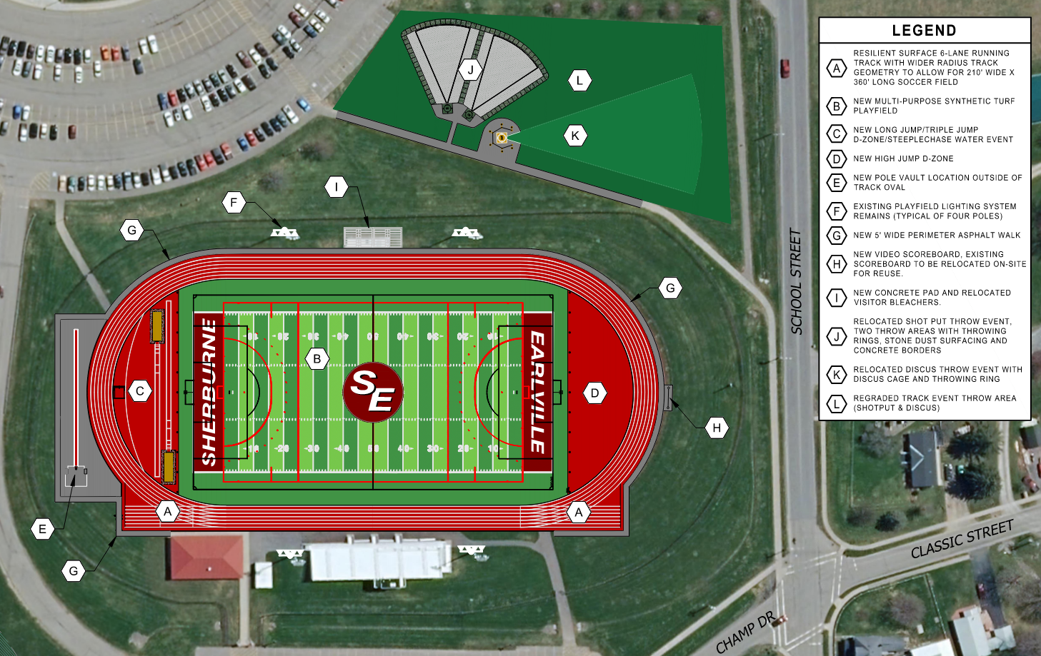

Slide 15
Project Financials

Slide 16
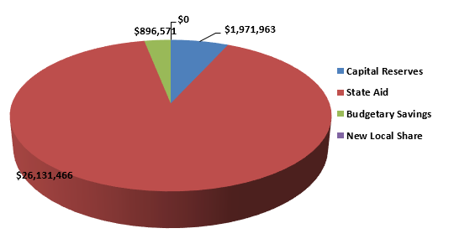
Total Referendum: $29,000,000
No Additional Tax Impact
Capital Reserve $1,971,963 State Aid $26,131,466 Budget Savings $896,571 New Taxes $0 Total $29,000,000 Financed over 15 years State Building Aid Ratio – 96.7%

Slide 17
Schedule

Slide 18
Schedule
Pre-Referendum | Design & Construction (Estimate)
Aug. 29, 2022 BOE Presentation Oct. 17, 2022 BOE Resolutions Oct.-Dec. 2022 Community Engagement Nov. 2022 Public Meetings Dec. 13, 2022 Voter Referendum | Jan.-Dec. 2023 Design Jan.-Mar. 2024 SED Review Mar.-Apr. 2024 Bidding May 2024-Dec. 2026 Construction

Slide 19
Questions & Answers

Slide 20
Capital Improvement Project
REMEMBER TO VOTE
Tuesday, December 13, 2022
Noon to 8:00 p.m. | MS/HS Auditorium Entrance

