Slide 1
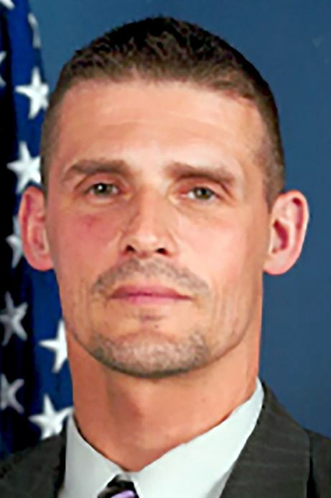
SHERBURNE-EARLVILLE BOARD OF EDUCATION 2023 Candidate Thomas Jusianiec
My name is Thomas M. Jusianiec. I am a SECHS graduate, class of 1990. Upon graduation I obtained my Bachelor of Science in Business Administration and Accounting from Elmira College. After graduating
from college, I ran the family Tree (Jerry and Sons County Line Tree Farm) up until 1999. Always desiring to work in Federal Law Enforcement, I obtained my first position as a Criminal Investigator for the Dept. of Treasury, IRS-CID, Peoria, Illinois investigating financial crimes and drug trafficking. In 2003, I transferred to the Dept. Of Justice, Bureau of Alcohol, Tobacco, Firearms and Explosives, Burlington and Rutland, Vt. as a Criminal Investigator investigating violent crime with the use of firearms and explosives. In 2013, I was promoted to the Resident Agent in Charge of the ATF Syracuse, NY Field office.
Subsequently, with my transfer my family and I moved back to the Sherburne-Earlville area and we enrolled both of our children in the SE school district. My daughter, Alexia graduated in 2022 and my son, Tomek will graduate in 2026. From 2017-2019 I coached Little League Baseball and Optimus Basketball. I have spent the last 25 years as a Federal Law Enforcement Officer and am also a local small business/farm owner (County Line Tree Farm, Goose Hill Farms BnB, Goose Hill Farms).

Slide 2
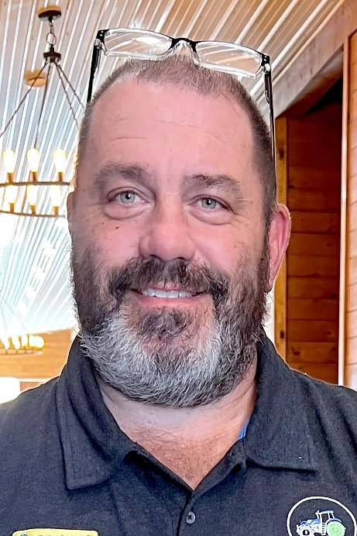
SHERBURNE-EARLVILLE BOARD OF EDUCATION 2023 Candidate Ed Potrzeba, Jr.
Ed Potrzeba, Jr. age 50, owner of NY Hay Sales a 1,500 acre hay farm in Earlville. Ed along with his wife Heather and sons’ Eddie (senior) and Charlie (sophomore) moved to Earlville in 2016 to pursue a dream of owning and operating a farm. Attracted to the area by the beautiful rolling hills and vast open space, Earlville seemed like a great place to bring our boys up and the farm would give them a chance to build a work ethic and enjoy nature.
Ed owned & operated Ed & Ed Business Technology, Inc. until 2020 when he sold the business to focus on NY Hay Sales. A graduate of SUNY IT/UTICA in 1996 with a bachelors of business administration. Ed’s company with a staff of 35 employees specialized in the sales and service of copiers, printers, and mailing equipment to businesses across New York State. For 30 years Ed worked with school board members, superintendents, business officials, principals, IT directors, guidance departments and BOCES. Ed was personally responsible for the K-12 public school accounts throughout New York State. Well respected among school district officials in Oneida, Madison, Herkimer, and Onondaga counties, many to this day have become personal friends of Ed. Past Industry Co-Chair of the Mohawk Valley Regional Postal Customer Council. Ed enjoys hunting, fishing, snowmobiling, and boating. Ed looks forward to the opportunity to serve the students, parents, and community members of the Sherburne-Earlville Central School District.

Slide 3
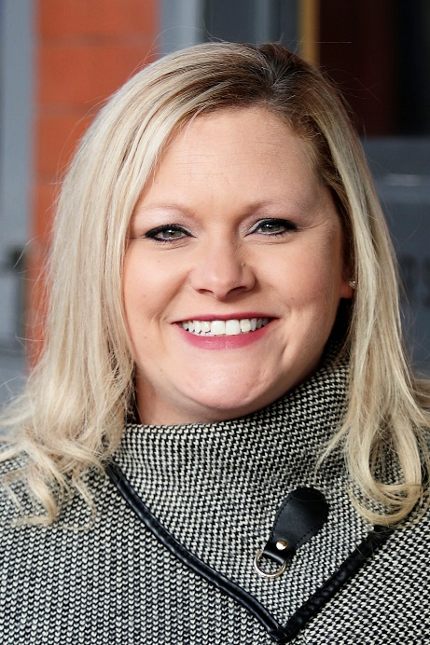
SHERBURNE-EARLVILLE BOARD OF EDUCATION 2023 Candidate Jerri Webb
Jerri Webb grew up in our local area, graduating from Hamilton Central School. She broadened her horizons as she pursued higher education earning a Bachelor of Arts degree in Sociology with dual minors in Political Science and Psychology from St. John Fisher College. Jerri went on to earn her Master of Arts degree in Childhood Studies from Rutgers University before returning to Sherburne, New York to build her career and family. In her professional life, she is a Scrum Master for a Meta Scrum Team driving improvements with procedures and robotic process automation at Frontier Communications.
Jerri values being actively engaged in our community and as a graduate of the Leadership Chenango Class of 2022, she has gained exposure to the services, resources, issues, and perspectives affecting Chenango County. As a servant leader in our community, Jerri is a Board Member for the United Way of Mid-Rural New York, working to create long-lasting change in financial stability, education, and health. She is also actively engaged in our local youth sports programs and currently serves as Secretary for the Sherburne Area Little League. In her free time, Jerri enjoys camping with her family and practicing her golf skills. She wears many hats as a wife and mother of two children, to include scheduler, chauffer, and keeper of the uniforms.
Jerri is interested in representing our community as a member of the Board of Education as she strives to identify opportunities for positive change that will shape the future for our children. Transparency and accountability are important to Jerri; she believes that both are key to building the relationship between our School District and Community. She is focused on providing the best quality
and variety of opportunities for our students while also retaining strong educators and staff who are vital to that success.

Slide 4
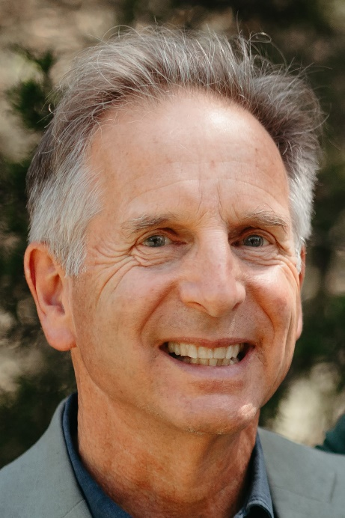
SHERBURNE-EARLVILLE BOARD OF EDUCATION 2023 Candidate Harmon Hoff
If re-elected to the SECSD school board I will continue to listen, ask questions and bring an open mind to solve the challenges facing our school. I will continue to collaborate with other board members, administrators and members of the community to ensure that our students are literate, problem solvers, ready to brighten their own and this community's future.
During my first term the Board and Superintendent Berson: created our Strategic Plan, earned community support for a major building project, updated the administrative structure of the District by adding a Director of Curriculum and maintained a healthy and prudent budget.
I am a parent, husband, retired farmer and retired high school teacher. I have lived and worked in this school district and on my family's farm since 1981.
After one Board term, twenty years of teaching and parenting I am very familiar with the operation of our school. Running and managing a large farm makes me aware of the challenges of using property taxes to support our school. I recognize our school not only serves students, but is the largest employer in our community. Our mission is to serve children but we are essential to the economic well being of all.
While on the Board I have served on the Finance Committee, Facilities Committee, Policy Committee and Links. I am the District's Representative to the Broome, Tioga, Delaware Health Consortium and serve on its' Rates Committee. In this capacity I have helped bring hundreds of thousands of dollars back to the district and increased the transparency of the Consortium.
I intend to continue my active involvement in these Board Committees if re-elected.
I am a past President of the Earlville Library and while on that board I served on the Mid-York Library System Board. I spent 3 years there as Board Treasurer. For twenty five years I have chaired the Town of Hamilton Zoning Board of Appeals. There I work with a committee to balance rules and regulations with the specific needs and problems individuals face.
I believe my broad background makes me well qualified to work with other school board members to preserve and improve our excellent school district.

Slide 5
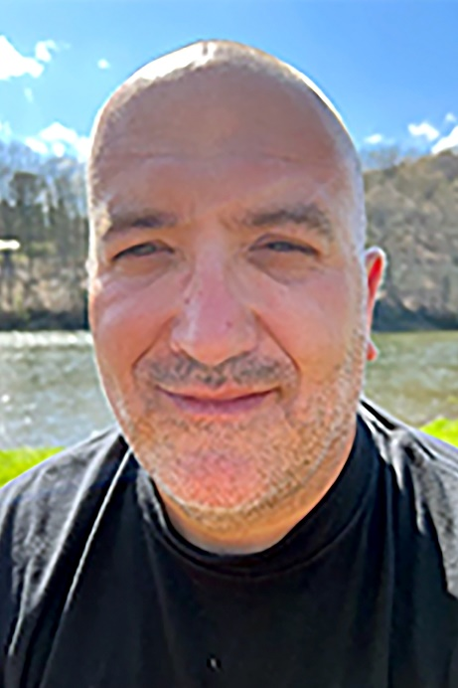
SHERBURNE-EARLVILLE BOARD OF EDUCATION 2023 Candidate Mike Barone
My name is Mike Barone. I'm 46 years old and I live in Plymouth. I am married with two children one who is in 6th grade (Layne) and one who is in kindergarten (Kash) both who attend SE.
I am a self employed business/restaurant owner, I have four total one in Delaware County and three here in Chenango County. All four are very involved in the community and school districts in the towns which they are located!
Running these businesses has given me many skill sets such as budgeting, community outreach, planning, and problem solving. I have a strong passion for the outdoors as well.
My reason for running for a position on the school board is I believe it is a great opportunity to get more involved and advocate for not only my children but other students in the district.

Slide 6
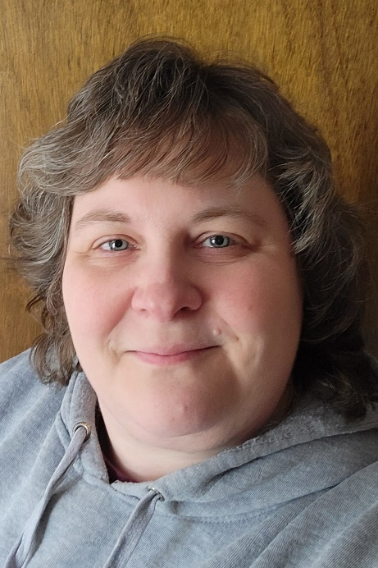
SHERBURNE-EARLVILLE BOARD OF EDUCATION 2023 Candidate Tina Baker
Tina Baker, a 1992 graduate of Sherburne-Earlville, has lived in Sherburne most of her life. She left to attend college at Rochester Institute of Technology where she graduated with a Bachelor of Science degree in accounting.
Tina spent the last three decades utilizing her accounting degree, a passion that started here at Sherburne-Earlville, in various capacities. She is currently a Financial Analyst for Golden Artist Colors, serves as a fiscal consultant for Madison County Rural Health Council, is on the Finance Committee for United Way of Mid Rural New York and serves on the Finance and Audit committees for the Sherburne-Earlville Board of Education.
Tina shared nineteen wonderful years with her husband, Ron, prior to his passing in July 2019. Their oldest son, Jake, is a 2022 graduate of Sherburne-Earlville and is wrapping up his first year at SUNY Delhi. Their youngest son, Matt, is a freshman at Sherburne-Earlville. Tina resides in the Village of Sherburne with her sons.

